Slide 1
var title = “Mystery talk”;
var info = {
name: “martinChaov”,
foo: “bar”
};
Notes:
It’s a mystery why someone is going to talk about math problems to a semi-drunk crowd …
1. Interesting case where a lot of the CS knowledge is needed
2. Need to do a lot of calculations on the front-end and do them fast, and that is always interesting to do :)
3. Some of the established good practices are not applicable in this case
As this is a lightning talk, I am going to haste over the content, if you are interested in something specific – ask, and I might answer ☺

Slide 2

Notes:
The beer challenge.
How many beers to how many people up to how much they could drink!
How many combinations are possible with 20 brands of beer?

Slide 3
A + B + C + D
…
…
Notes:
That sounds simple …
... in terms of math this is basically: ``` (A * B) + (C * D) ...``` - N number of times
We need to only calculate all the possible COMBINATIONS out of the set.
Combinations mean, we don’t care about order and we don’t accept repeats in our case …

Slide 4

Notes:
Just wait a second there…
If we put there 20 beers, this gives us 1 048 575 combinations… WAT?
I need to be able to generate 1 000 000+ combinations and aggregate the odds on the fly … with JS?!?!?!

Slide 5
.1 + .2 // 0.30000000000000004
2.01 + 2.02 // 4.029999999999999
.1 * .2 // 0.020000000000000004
2.05 * 10 // 20.5
2.05 * 100 // 204.99999999999997
2.05 * 1000 // 2050
2.05 * 100000 // 204999.99999999997
999999999999999 // 999999999999999
9999999999999999 // 10000000000000000
Notes:
One of the languages that treat numbers like that…

Slide 6
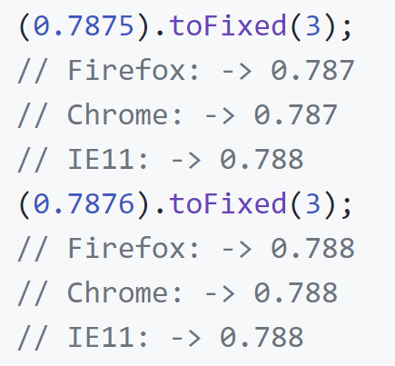

Slide 7

Notes:
At that moment I already was screaming out in pain and I was rejecting this idea…
After some inspiring conversation with my bottle and…

Slide 8
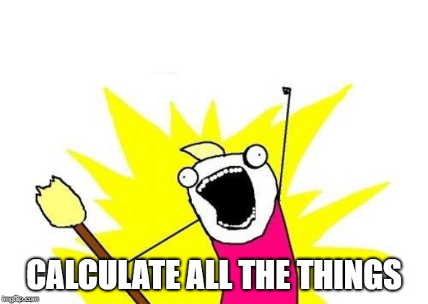
Notes:
…one alcohol induced happiness later … I had a new perspective on life …
Let’s calculate all the things …
What are “all the things”?!

Slide 9
A + B === B + A
Notes:
As I said earlier – order doesn’t matter.
It doesn’t matter because the operations I need to do are Commutative.

Slide 10




Notes:
Well let’s prettify this a bit…

Slide 11
Notes:
Well let’s prettify this a bit…

Slide 12

Notes:
There are non-combinable selections

Slide 14


Notes:
A and A1 cannot be combined
B and B1 cannot be combined

Slide 15
Notes:
A “cartesian product” later – we get 4 sets…

Slide 16
Notes:
Well let’s prettify this a bit…

Slide 18
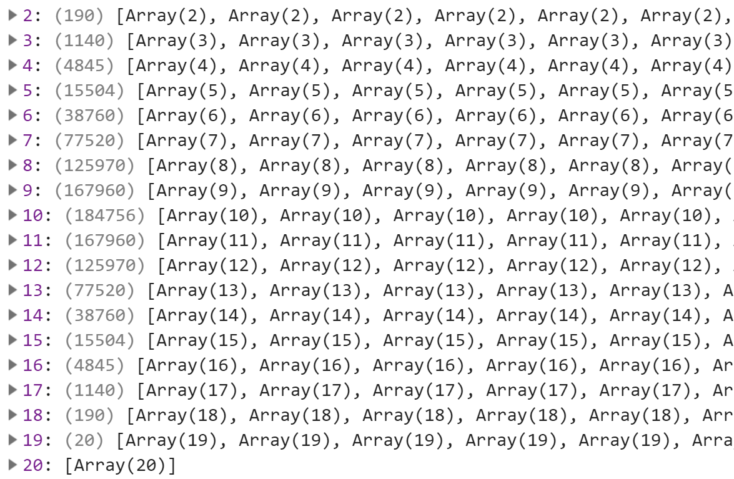
Notes:
Back to reality for a second …

Slide 19
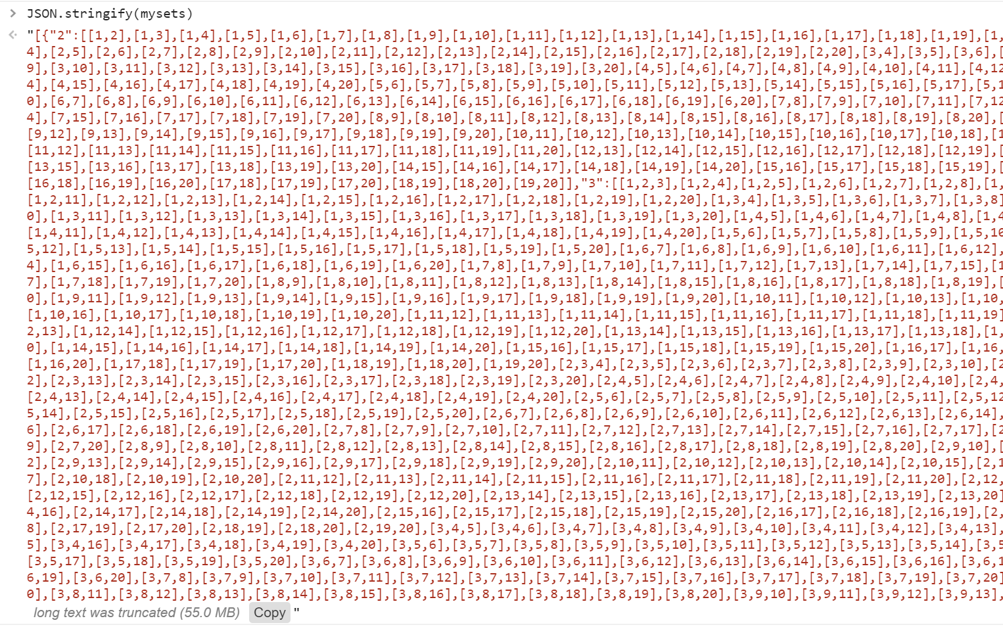

Slide 20

Generate
sets:
500ms
Notes:
Well that sucks…

Slide 21
Aggregation?
A + B + C + D
…
…
Notes:
Milliliters aggregation

Slide 22
Milliliters
aggregation:
~25ms
Notes:
Well that sucks… it means total time is between 150+ ms…
And also – when we adjust the volume – I need to re-generate the sets and then re-aggregate the mls…
So maybe we can optimize by boxing the values and store them as reference…
Can you guess if the result went up or down?!

Slide 23
Optimization time…
function box(n){
return {
value: n
};
}
Notes:
Odds aggregation

Slide 24

Generate sets:
500
ml. aggregation:
1400
Notes:
Well that sucks…

Slide 25
Optimization time…
const proto = {
value: 0
}
function box(n) {
let x = Object.create(proto);
x.value = n;
return x;
}
Notes:
Odds aggregation

Slide 26
Generate sets:
400ms
ml. aggregation:
1000ms
Notes:
Well that sucks… we were able to increase the exec time by a factor of 10 by optimizing it to execute less times …
So let’s remove the boxing…

Slide 27
Optimization time…
var temp = [];
VS
var temp = new Array(#);
Notes:
Arrays allocation
It is cheaper to pass arrays are reference and mutate them .. Duh

Slide 28
Optimization time…
temp.push(#);
VS
temp[#] = #;
Notes:
It is cheaper to compute than to allocate
1 048 555 arrays of numbers are cheaper than 1 048 555 arrays of boxed values (kind of makes you think about observables here…)

Slide 29
Generate
sets:
~150ms
Notes:
Well that’s better…

Slide 30
Thinking about it…
Referenced vs Immutable
Allocations vs Computation
Computation vs Allocation
Imperative vs Declarative
Notes:
Caching is faster than calculating

Slide 31
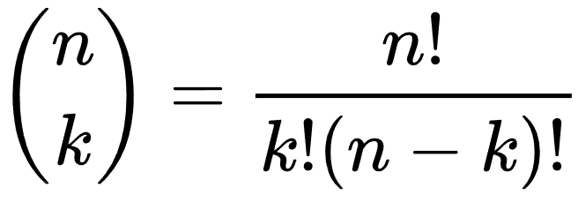
Optimizations - bonus round!
Binominal coefficient
Factorization
Dynamic programming
Memoization
Notes:
The binomial coefficients occur in many areas of mathematics, and especially in combinatorics. The symbol {\displaystyle {\tbinom {n}{k}}} is usually read as "n choose k" because there are {\displaystyle {\tbinom {n}{k}}} ways to choose an (unordered) subset of kelements from a fixed set of n elements.
**Dynamic programming** (DP) means solving problems recursively by combining the solutions to similar smaller overlapping subproblems, usually using some kind of recurrence relations. (Some people may object to the usage of "overlapping" here. My definition is roughly taken from Wikipedia and Introduction to Algorithm by CLRS.) I will only talk about its usage in writing computer algorithms. Note that an actual implementation of DP might use iterative procedure.
DP is a solution strategy which asks you to find similar smaller subproblems so as to solve big subproblems. It usually includes recurrence relations and memoization.
Memoization is a technique to avoid repeated computation on the same problems. It is special form of caching that caches the return value of a function based on its parameters.
**Memoization** means the optimization technique where you memorize previously computed results, which will be used whenever the same result will be needed. Memoization comes from the word "memoize" or "memorize".

Slide 32
X of 20 | Combos | Time (ms)
2 | 190 | ~ 0.05
3 | 1 140 | ~ 0.3
4 | 4 845 | ~ 2
5 | 15 504 | ~ 4
6 | 38 760 | ~ 11
7 | 77 520 | ~ 14
8 | 125 970 | ~ 17
9 | 167 960 | ~ 30
10 | 184 756 | ~ 35
Notes:
Some results…
Nice property of combinations – things are repeating
2 and 18 out of X give you 190 combos
3 and 17 …
Etc…
TOTAL COMBOS for all X choose Y:
1 048 575 (includes singles and straight)
TOTAL TIME:
180.22 ms.

Slide 33


Slide 34

Say hi!
Github: https://github.com/mchaov

